Slide 1
HMT 801 Travel Agency and Tour Operations
UNIT 4
Travel Entrepreneurship and Sustainable Marketing
Topic
Tour Package Costing and Sustainable Marketing
Course Outcome (CO)
CO5: Evaluate the Sustainability of Travel operations and activities of travel bodies and associations

Slide 2
TOUR COST DEFINITION
Tour cost means the total cost incurred or attributed to a tour product service or in other words we can say that the tour cost is the sum total of costs incurred to create or formulate a tour package

Slide 3
Elements of the cost of a tour
Accommodation Cost
Transfer Costs
Administrative Costs
Research And Development Cost
Travel Cost
Marketing Costs
Sightseeing And Activity Costs
Miscellaneous Costs

Slide 4
FACTORS AFFECTING THE TOUR COST
Seasonality
Foreign Exchange fluctuation
Competitors’ price strategy
Increase in other costs.
Impact of liberalization and globalization
Promotional pricing/ special discounts
Quality value ratio

Slide 5
Technical terms
Mark up: Amount added on cost price
Buying power: Used to increase profit by reducing the price from principal suppliers.
Cash flow: Money going out and coming into the business.
Net rate: Prices of the supplier meant for the retailers on which you base prices.
Gross rate: rate which supplier quotes to you for his or her products.

Slide 6
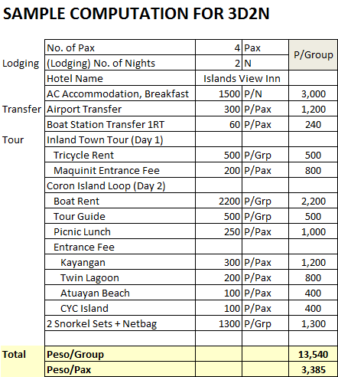

Slide 7
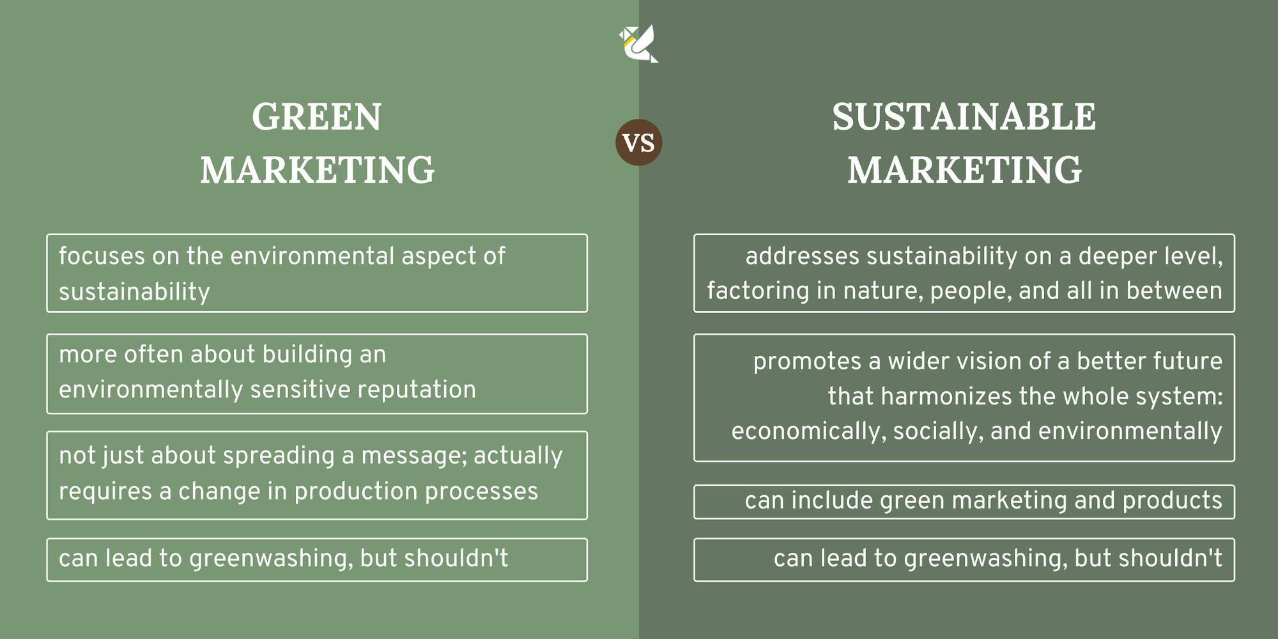

Slide 8
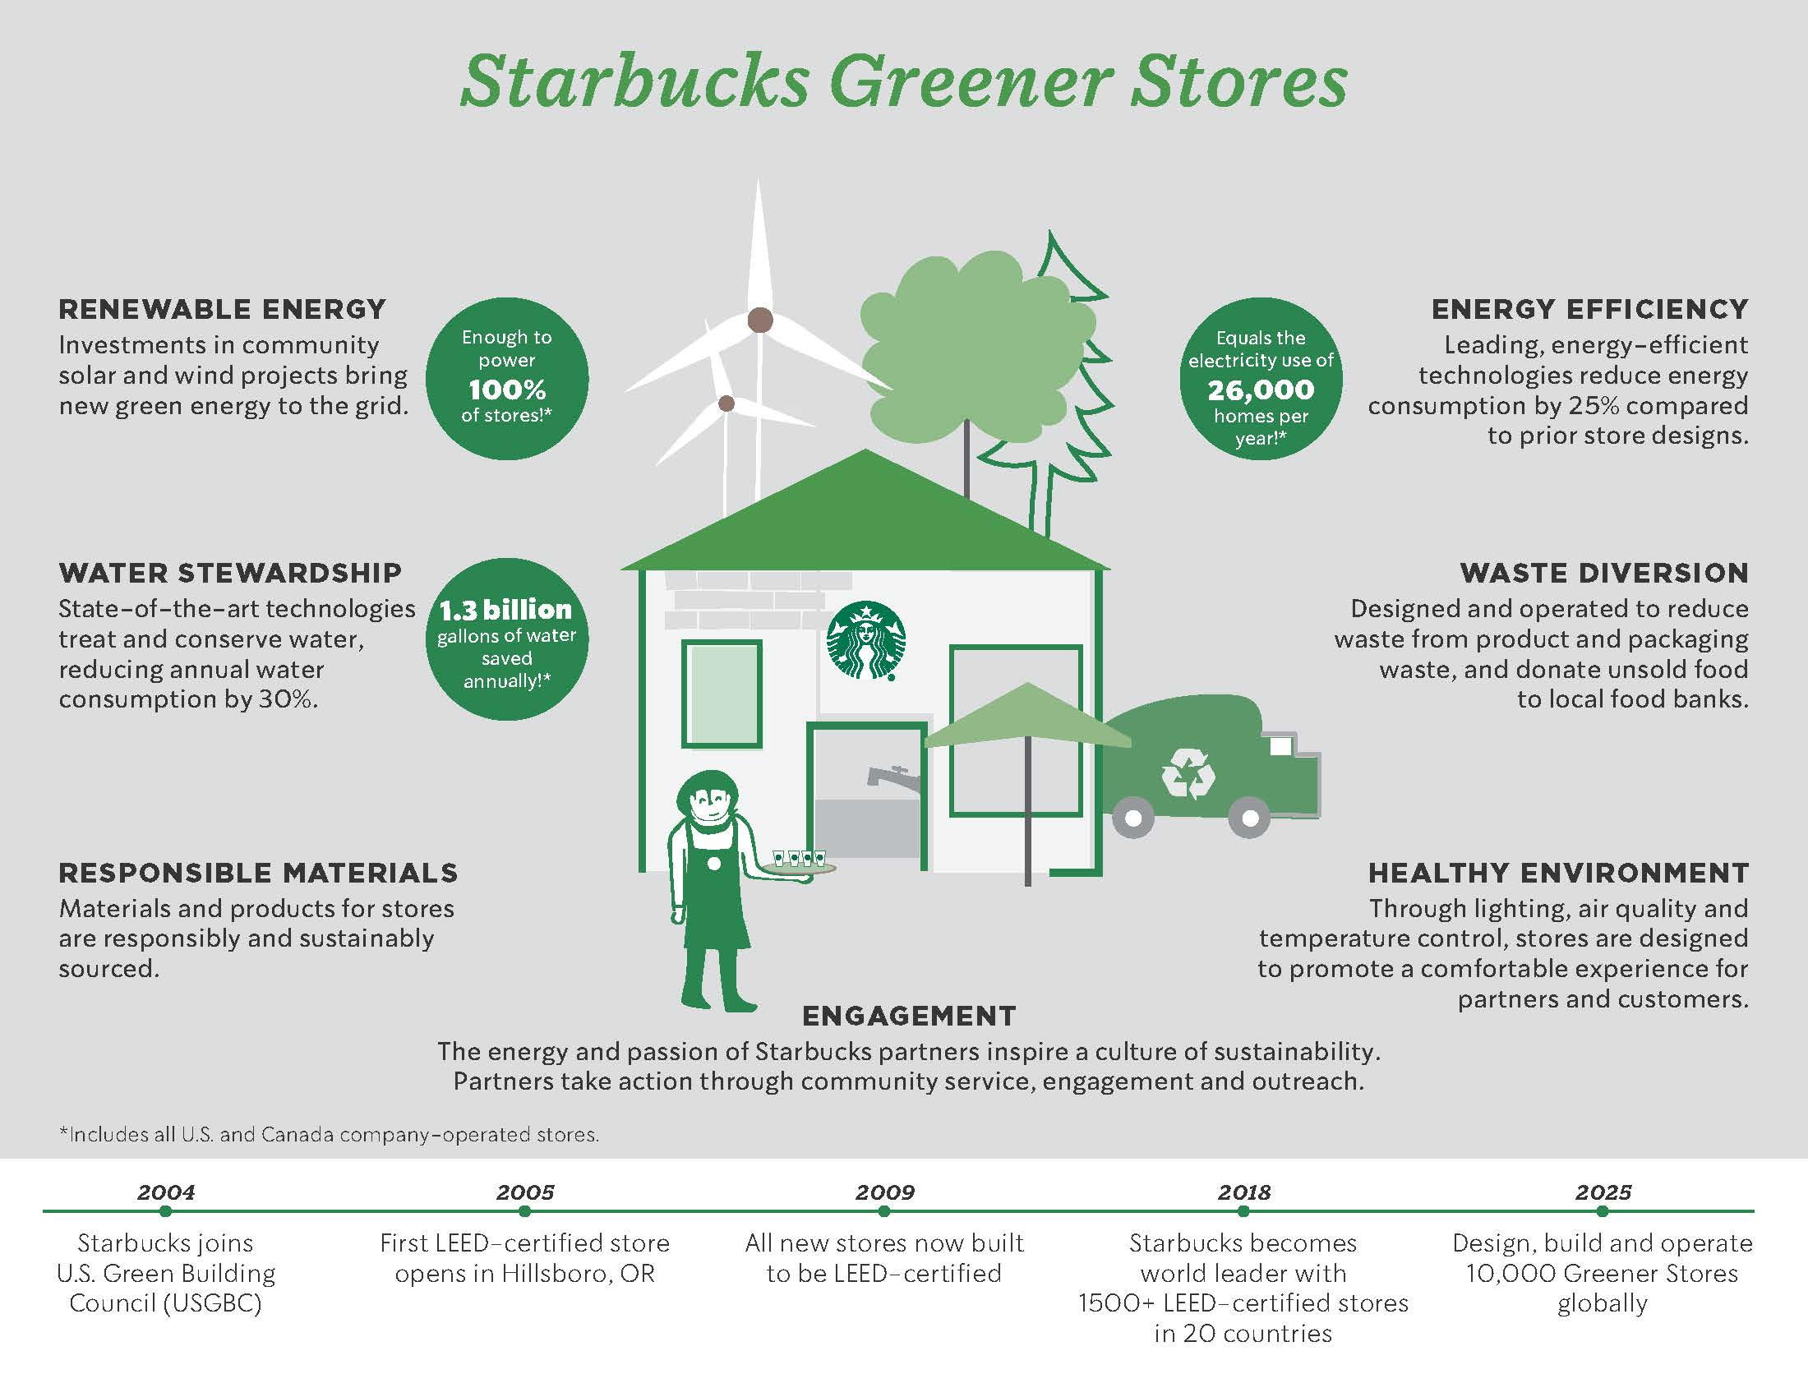

Slide 9
